Slide 1
macrix
TECHNOLOGY GROUP
SRP has a superpower - understand it and take your code to the next level
You will understand that SRP is like air, it surrounds you everywhere and is all you need
We code IT happen
macrix.eu
Notes:
Welcome to the workshop on SRP and other related topics. My name is Tomasz Dzidek and I'll show you how easy it is to see when to split a class, how to make your code more readable, and how not to complicate your code at the beginning, but only when business requirements require it.
Let’s start with the workshop plan...

Slide 2

macrix.eu
Everything you use in programming is based on the
single
responsibility
principle.
Notes:
Maybe some of you are now thinking - Tomek, you are a liar, I know more then SRP...... But... Let's see and explore this topic

Slide 3
macrix.eu
Workshop plan
What Single Responsibility Principle is?
Introduction to cohesion and coupling.
Exercises to use the knowledge you have just acquired.
What is and how to measure cyclomatic complexity?
The hardest thing in programming is...
Exercises to use the cyclomatic complexity.
When make the refactor of the current code?
Practice session on how to deal with new business requirements.
Notes:
Let’s start with workshop plan...
What Single Responsibility Principle is?
I shortly describe what SOLID is and what SRP means in more detail.
Introduction to cohesion and coupling.
We will be talking about why coupling and cohesion are important in the context of SRP.
Exercises to use the knowledge you have just acquired.
We will practice the knowledge you have just acquired.
What is and how to measure cyclomatic complexity?
I will introduce what cyclomatic complexity is.
The hardest thing in programming is...
Ask people what they think is the hardest thing in programming.
Exercises to use the cyclomatic complexity.
Practice session with cyclomatic complexity.
When make the refactor of the current code?
My point of view of when we should make the refactor.
Practice session on how to deal with new business requirements.
We will practice our daily basis work - refactor the code when new requirements appear.

Slide 4
macrix.eu
What is a SOLID?
In software engineering, SOLID is a mnemonic acronym for five design principles intended to make object-oriented designs more understandable, flexible, and maintainable
The Single-responsibility principle: There should never be more than one reason for a class to change. In other words, every class should have only one responsibility.
The Open–closed principle: Software entities ... should be open for extension, but closed for modification.
The Liskov substitution principle: Functions that use pointers or references to base classes must be able to use objects of derived classes without knowing it.
The Interface segregation principle: Clients should not be forced to depend upon interfaces that they do not use.
The Dependency inversion principle: Depend upon abstractions, [not] concretions.
Notes:
The Single-responsibility principle:
I will be talking about it in a minute
The Open–closed principle:
The class should allow its behavior to be extended without modifying its source code.
The Liskov substitution principle:
Simply put, the Liskov Substitution Principle (LSP) states that objects of a superclass should be replaceable with objects of its subclasses without breaking the application.
The Interface segregation principle:
And no code should be forced to depend on methods it does not use. In other words ISP splits interfaces that are very large into smaller and more specific ones so that clients will only have to know about the methods that are of interest to them
The Dependency inversion principle:
We should composite (build) bigger functionality by using interfaces (contracts) not concrete implementations
Let’s talk about SRP

Slide 5
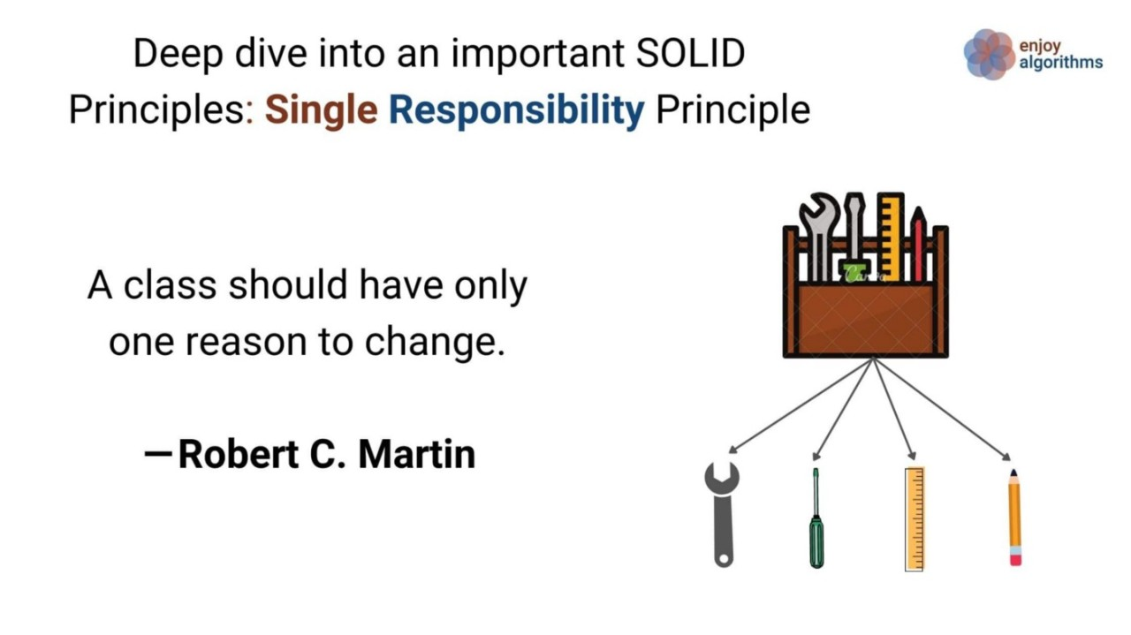
macrix.eu
SRP – Single responsibility principle
The single-responsibility principle (SRP) is a computer programming principle that states that A module should be responsible to one, and only one, actor. The term actor refers to a group (consisting of one or more stakeholders or users) requiring a module change.
In other words, each class should have one reason to change.

Slide 6
macrix.eu
Introduction to cohesion and coupling
Coupling and Cohesion are two key concepts in software engineering that are used to measure the quality of a software system’s design.
Coupling refers to the degree of interdependence between software modules. High coupling means that modules are closely connected and changes in one module may affect other modules. Low coupling means that modules are independent and changes in one module have little impact on other modules.
Cohesion refers to the degree to which elements within a module work together to fulfill a single, well-defined purpose. High cohesion means that elements are closely related and focused on a single purpose, while low cohesion means that elements are loosely related and serve multiple purposes.
More details: https://www.geeksforgeeks.org/software-engineering-coupling-and-cohesion/

Slide 7
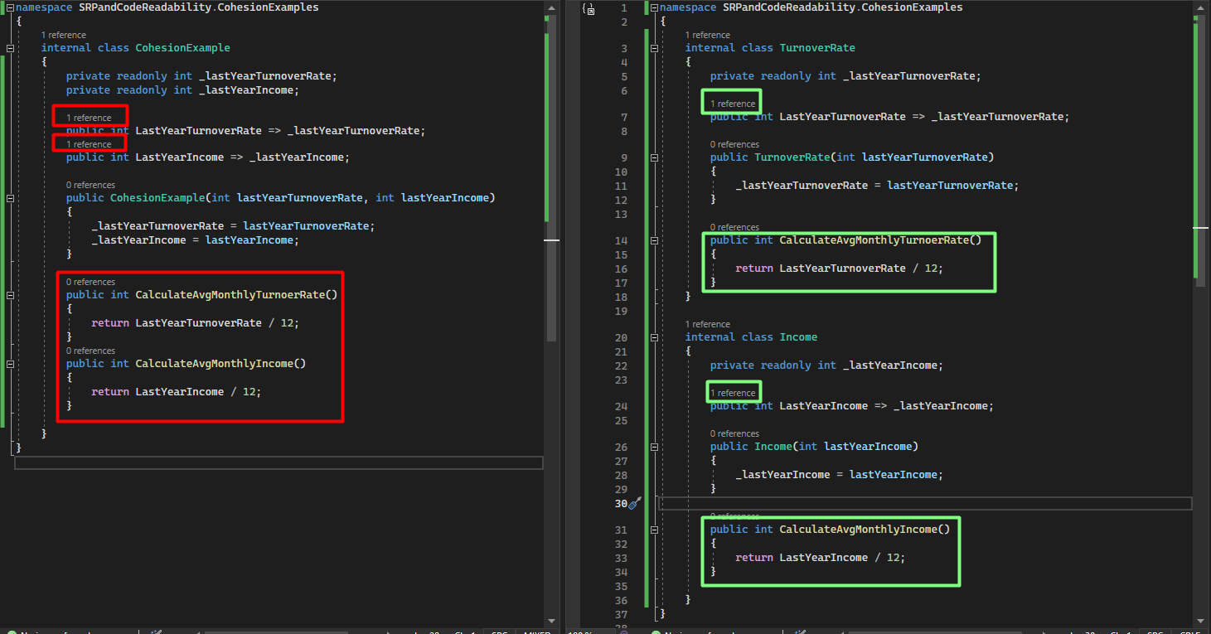
macrix.eu
What cohesion has common with SRP?
If Cohesion is too low, the class should be split...
But can I easily see when cohesion is low?
When the number of public method
is bigger the usage of property
More information:
https://hub.packtpub.com/microsoft-visual-studio-2010-improving-class-quality-cohesion/

Slide 8
macrix.eu
Exercise 1
Open the Exercise1 project and rewrite program files to follow the SRP principle

Slide 9
macrix.eu
Exercise 2
Open the Exercise2 project and rewrite program files to follow the SRP principle

Slide 10
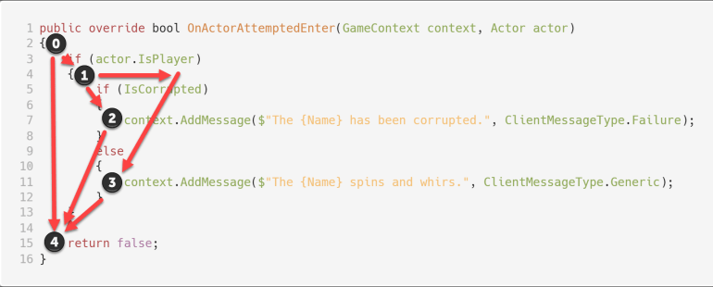
macrix.eu
What is cyclomatic complexity?
Cyclomatic complexity measures the number of linearly independent paths through the control flow graph of a program.
In practical terms, it can be interpreted as the minimum number of test cases required to achieve complete code coverage during testing.

Slide 11
macrix.eu
Is only the length of the method an indicator of maintainability?
Higher cyclomatic complexity values indicate a more complex program
with a larger number of potential execution paths,
which can make the code more error-prone
and harder to maintain.
Cyclomatic complexity is used by software developers and quality assurance teams to assess code complexity and can be a helpful tool in identifying areas of code that may need refactoring
or additional testing to improve software quality.

Slide 12
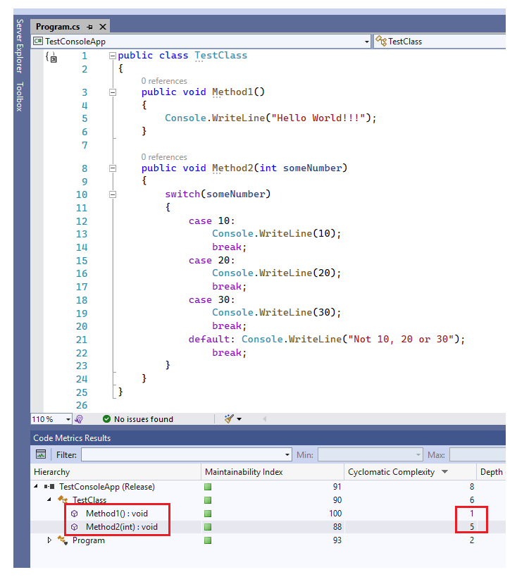
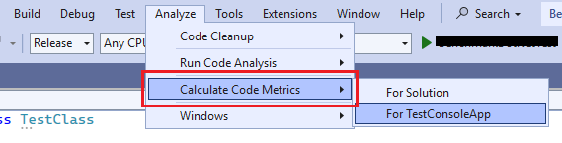
macrix.eu
How to measure cyclomatix complexity?
The tool is build in into Visual Studio
The Magic Number
As with many metrics in this industry,
there is no exact cyclomatic complexity limit
that fits all organizations.
However, NIST235 does indicate that
a limit of 10 is a good starting point.

Slide 13
macrix.eu
What is the hardest thing in programming?
Of course naiming...
But wait .......
What does naming have in common with SRP?

Slide 14
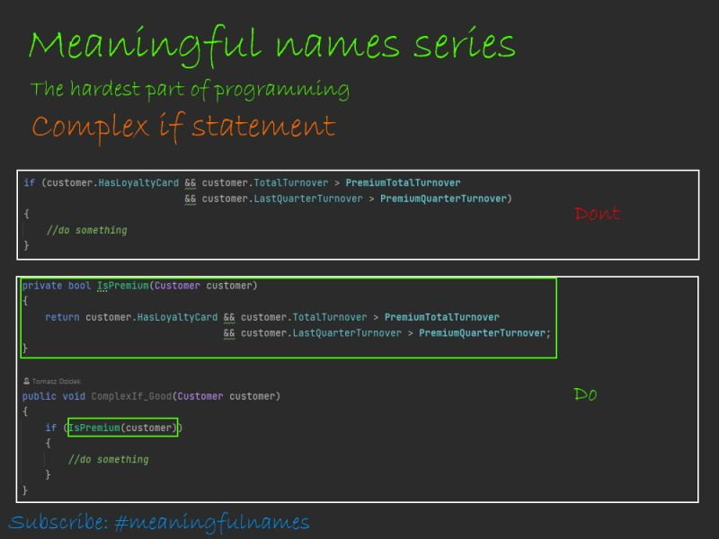
macrix.eu
When we should split
our methods into smaller?
Splitted methods have their responsibility
Proper naming says us
what the responsibility is
Proper naming gives us information
about intention
Proper naming allows us
to easily and quickly fix the bug
Proper naming is a easy way
to comply with
the Single Responsibility Principle
More details: https://www.linkedin.com/in/dzidektomasz/ComplexIf

Slide 15
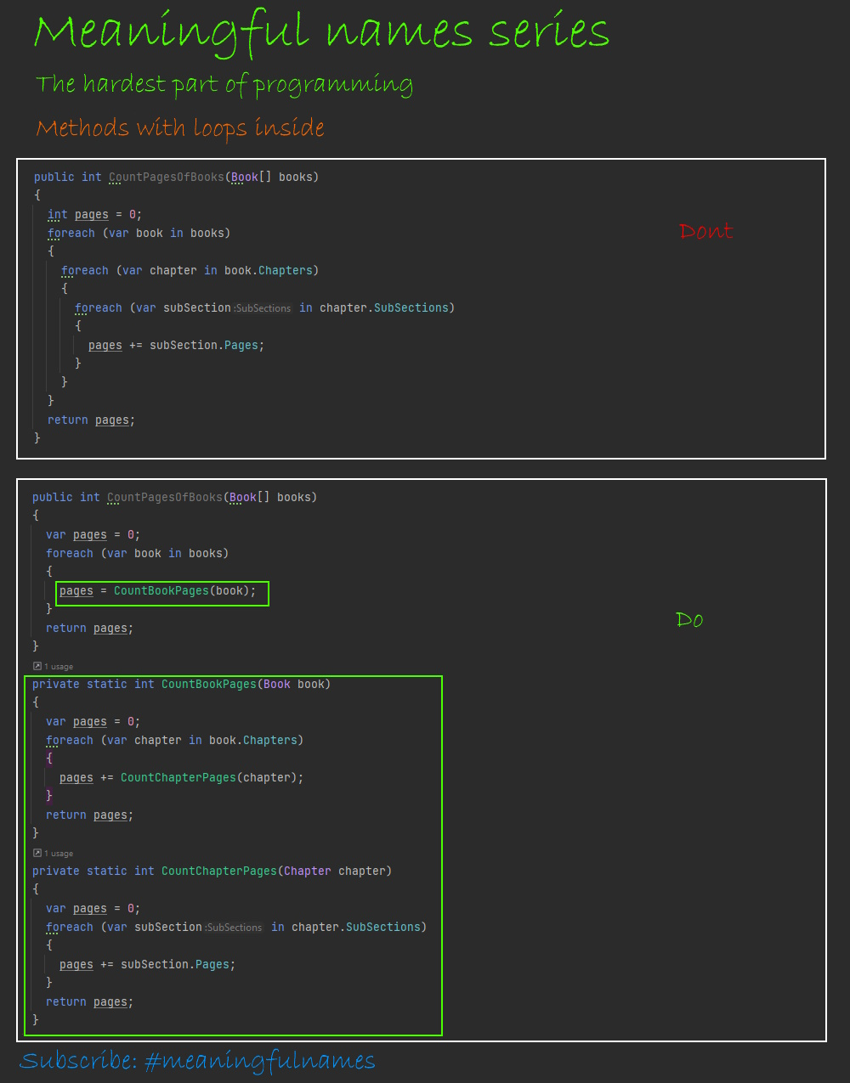
macrix.eu
When we should split
our methods into smaller?
Splitted methods have their responsibility
Proper naming says us
what the responsibility is
Proper naming gives us information
about intention
Proper naming allows us
to easily and quickly fix the bug
Proper naming as an easy way
to comply with
the Single Responsibility Principle
More details: https://www.linkedin.com/in/dzidektomasz/MethodsWithLoopsInside

Slide 16
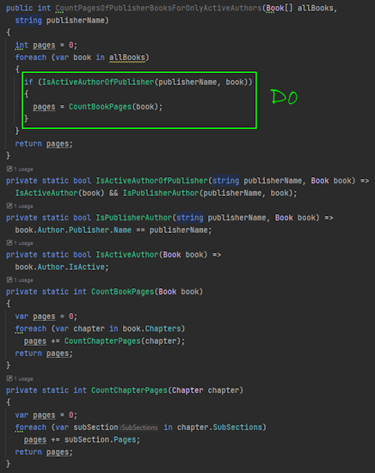
macrix.eu
Code as table of content
We usually read code more often than we write it, and we should be able to easily and quickly identify a piece of our code that interests us, in order to implement new functionality there or fix a bug
Smaller methods are the easiest to understand
The extracted method shows the intention and describes to us what the method should do, which gives us the opportunity to easily find an error.
Smaller methods allow us to read only the interesting part of the code, not the whole code
Code as table of content as an easy way
to comply with
the Single Responsibility Principle

Slide 17
macrix.eu
Exercise 3
Open the Exercise3 project and write a program to follow the SRP principle that meets business requirements:
Calculate the sum of incomes per client group but only for those with at least one premium customer.
Premium customers are that whose profit for the last 3 months is bigger than 3 000 000

Slide 18
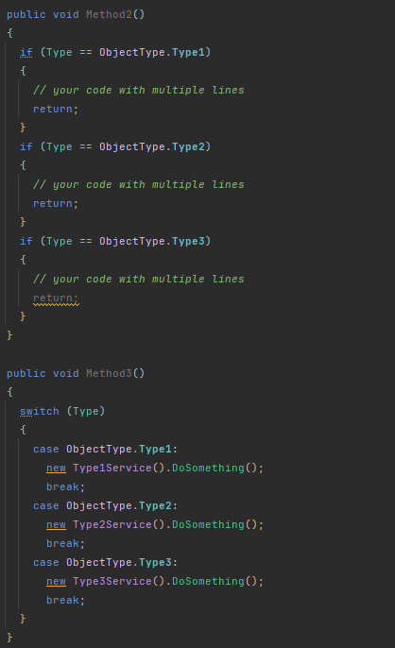


macrix.eu
When to refactor code?
You can fallow my two or three occurances rule:
When in method you have two conditions and you now that in the nearest future will be more conditions
When in method you have three conditions
Two or three occurances rule as an easy way
to comply with
the Single Responsibility Principle

Slide 19
macrix.eu
When DON’T refactor code?
When it works and you don't change the region
When you just think it might be useful in the future,
but it complicates the code and is time-consuming.
When you think this part should work faster, but no one else is complaining about it

Slide 20
macrix.eu
Exercise 4
Business has new requirements to application from exercise 3:
In group 0 they assign all customers from MARS, and their currency is worth 1000 times more valuable than ours. We are not able to change data structure

Slide 21
macrix.eu
Exercise 5
Business has new requirements to application from exercise 4:
Group 2 included all customers from a new market where they additionally spend 20% on advertising and would like to include these costs in the report

Slide 22
macrix.eu
But if SRP is principle connected to the classes only?
No, definetly no...
When we should applied SRP then:
Module level
Component level
Domain level
Solution level
Application level
Enterprise architecture level

Slide 23
macrix.eu
Excercise
Let's design a monolithic bookstore application that meets the following business requirements:
Before publication, authors are obliged to send the content of the book for verification
After verification, the books are available
Regular buyers have a discount
Subscribers can read books without purchasing them
The books are available in paper or e-book form
Users can rate books
Users can purchase books via transfer, credit card, loan and cash

Slide 24
macrix.eu
Excercise
Let's change the previous project to a modular monolithic application

Slide 25
macrix.eu
Excercise
Let's change the previous project to a microservices application

Slide 26
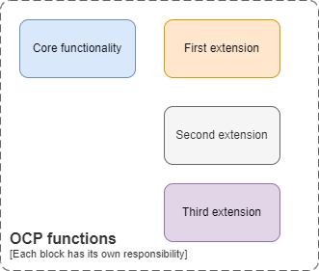
macrix.eu
SRP vs OCP (Open Close Principle)?
OCP – Open for extension, Closed for modification
Each block has its own responsibility
It means that OCP follow the SRP rule

Slide 27
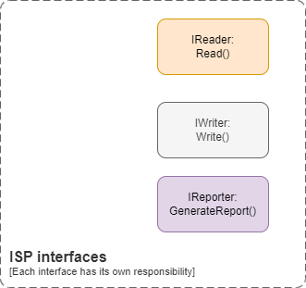
macrix.eu
SRP vs ISP (Interface Segregation Principle)?
ISP – Interface Segregation Principle
Each interface has its own responsibility
It means that ISP follow the SRP rule

Slide 28
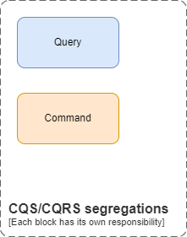
macrix.eu
SRP vs CQS or CQRS?
CQS – Command query segregations
CQRS – Command query response segregations
Each command or query has its own responsibility
It means that CQS and CQRS follow the SRP rule

Slide 29
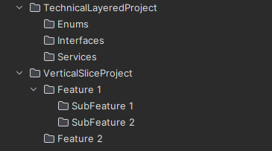
macrix.eu
SRP vs Vertical slices or domian devision of the project ?
Each layer has its own responsibility
It means that Vertical slices devision follow the SRP rule

Slide 30
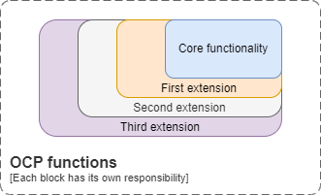
macrix.eu
SRP vs design patterns?
Decorator is a structural design pattern that lets you attach new behaviors to objects by placing these objects inside special wrapper objects that contain the behaviors
Each extension has its own responsibility
It means that Decorator pattern
follow the SRP rule

Slide 31
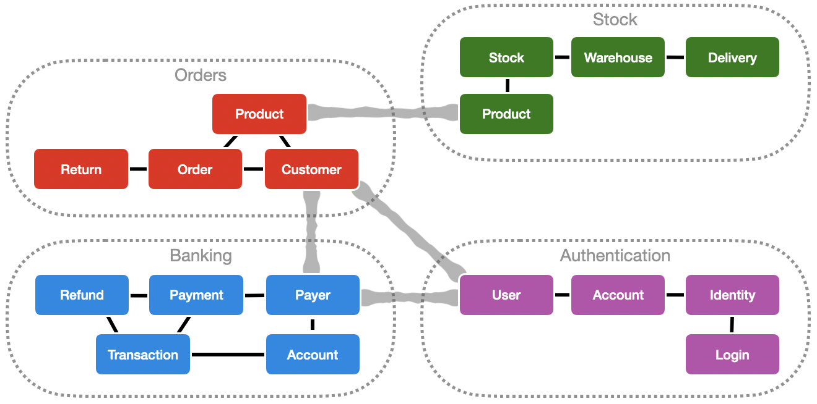
macrix.eu
SRP vs modules/comonents or bounded context from DDD?
Each modules/components has its own responsibility
It means that bounded context follow the SRP rule

Slide 32
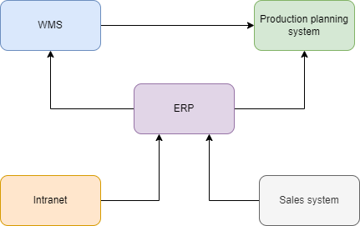
macrix.eu
SRP vs enterprise architecture?
Each system has its own responsibility
It means that enterprise architecture follow the SRP rule

Slide 33

macrix.eu
QA
Feedback: https://forms.gle/4Cghoe4cZyj5b1219

